Slide 1
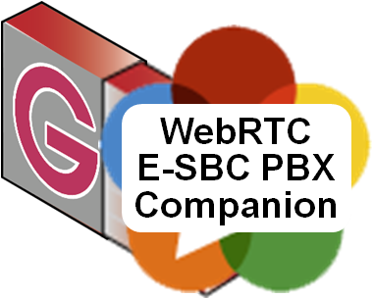
Karl Stahl CEO/CTO Ingate Systems info@ingate.com karl.stahl@intertex.se
Ingate’s SBCs do more than POTSoIP SIP. They were developed for standard compliant end-to-end multimedia SIP connectivity everywhere.
WebRTC is just aligned – Ingate adds Q-TURN telepresence quality and the WebRTC & SIP PBX Companion for the enterprise UC “social network”.
Merged Intertex Data AB and Ingate Systems AB

Slide 2
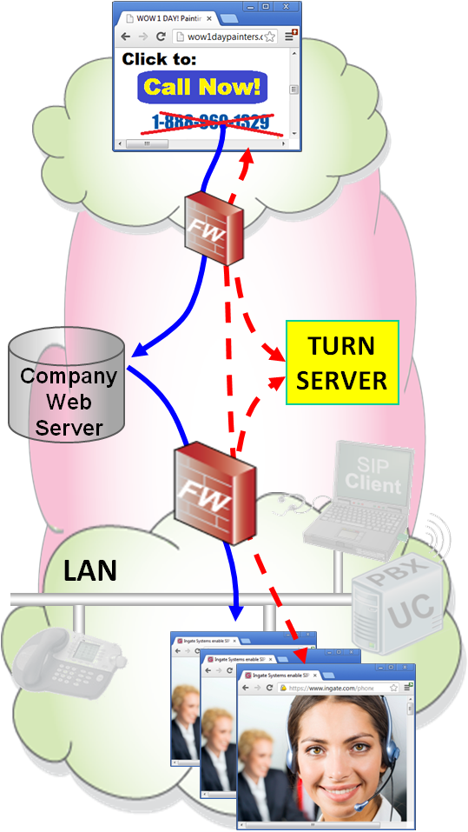
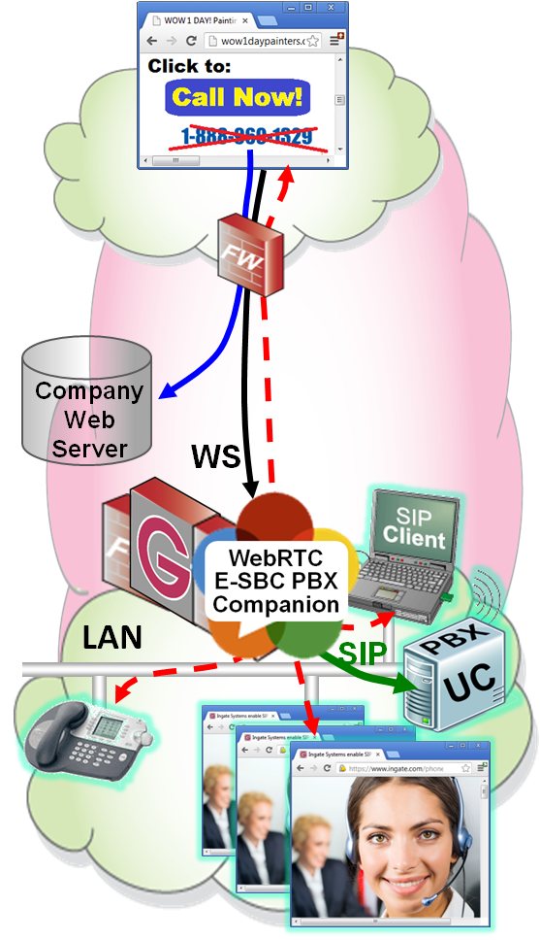
WebRTC & VoIP Security – Confusing it is…
What is actually meant by “securing WebRTC”, “managing security” etc.? What are the “security risks”? Says who?
Carrier: Theft of service, DoS/Overload, Don’t crash our systems
User: Privacy, Confidentiality would be nice
Enterprise data department: Don’t send malicious packets into our LAN…
Enterprise PBX / UC department: Make it work - always and everywhere, but don’t let intruders use our resources
And it is quite different:
WebRTC in itself
and integrated with the “Enterprise PBX / UC social network”

Slide 3
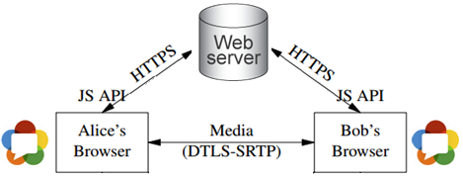
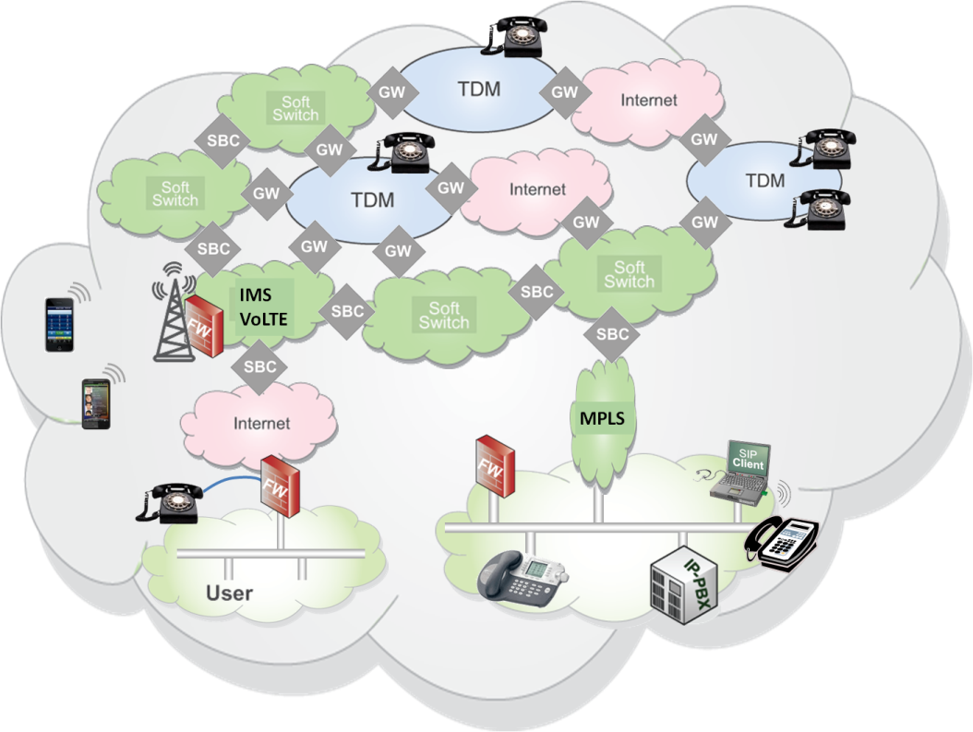
WebRTC in Itself has Excellent Privacy
Media is always encrypted between the endpoints. With DTLS-SRTP, only the browsers know the key.
Signaling is not standardized and most often over https (i.e. encrypted)
But that will not always be maintained when calls are gatewayed into other worlds
VoIP Service Providers seldom use encryption anywhere
Enterprise PBX / UC “social networks” are hiding behind a firewall or an SBC
Encryption is rarely used in the current PSTN and VoIP carrier world

Slide 4
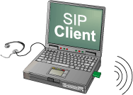
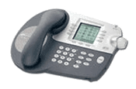
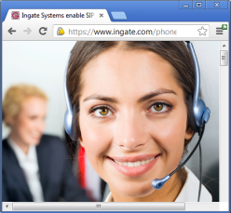
WebRTC in Itself is Quite Secure, but…
Turn server needs DoS protection
Does not traverse restrictive enterprise firewalls: ICE firewall traversal assumes open from the inside. Proposed media tunneling through open TCP 80 (http) or 443 (https) ports destroys quality. Data department may not want to open more.
Quality on data crowded pipes: WebRTC uses the Internet, where the access pipes are crowded with data traffic. No QoS possible since firewall is unaware of real-time traffic as ICE/STUN/TURN assumes.
Company
Web Server
Q-TURN RESOLVES
LAN

Slide 5
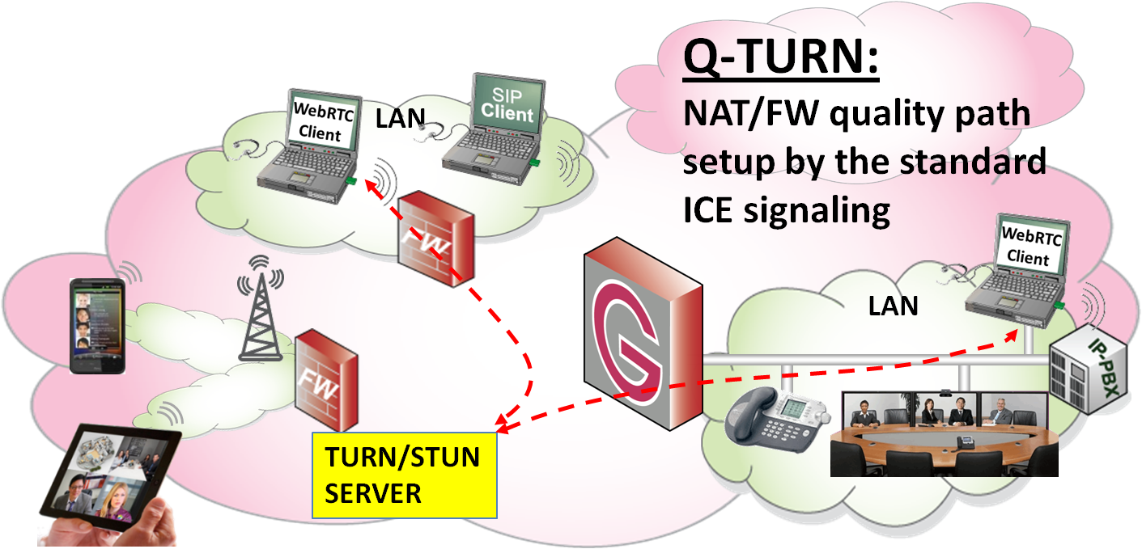
A Novel View on ICE – Q-TURN
Knock-knock; Give my Media a Quality Pipe
Regard ICE as a request for real-time traffic through the Firewall. Interpret the STUN & TURN signals in the Firewall
Have the STUN/TURN server functionality IN the Firewall and setup the media flows under control
Security is back in the right place - The firewall is in charge of what is traversing
Enterprise firewall can still be restrictive
Q-TURN
Q-TURN Enables QoS and More:
Prioritization and Traffic Shaping
Diffserve or RVSP QoS over the Net
Authentication (in STUN and TURN)
Accounting – Payload Type is seen

Slide 6
A WebRTC-SBC? Part of a Gateway it is (Unless you regards the Q-TURN Firewall as an SBC)
An enterprise wants to have the WebRTC benefits into their PBX / UC infrastructure. That is where their Auto attendant, Call Routing, Queues, Conference Bridge etc. is.
and an enterprise UC solution of course benefits from browser based clients, locally and remote
so does the IMS/VoLTE/RCS emerging networks
Such WebRTC – SIP Gateways require SBC functions like Security, Interoperability fix-ups and NAT/Firewall traversal
Company
Web Server
media
WS
LAN
SIP

